Slide 1
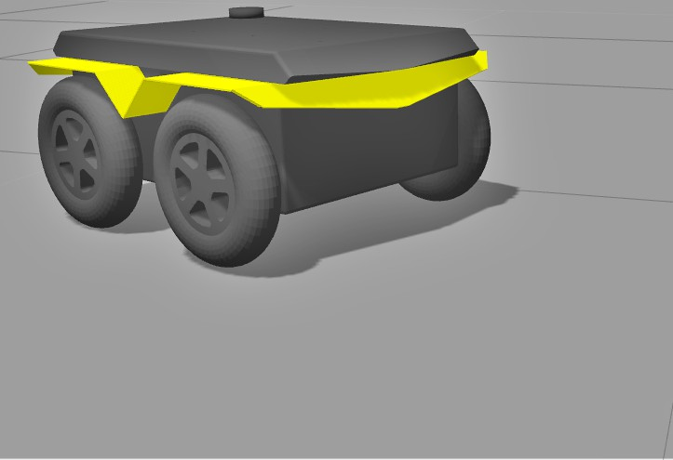
Project 2 - Group 3
Drunken Fox
EE 5900 - Intro to Robotics
Simulating a Jackal in Gazebo
Deep Doshi
James Radwill
Sabari Manohar

Slide 2
Problem Statement
Empty world
Random walk
&
Tele-operation
Step 1: Create an empty world with Jackal in Gazebo.
Step 2: Implement Random walk along with Teleop capability in-order to control the robot via keyboard if needed.
Step 3: Create a launch file run the project.
Launch

Slide 3
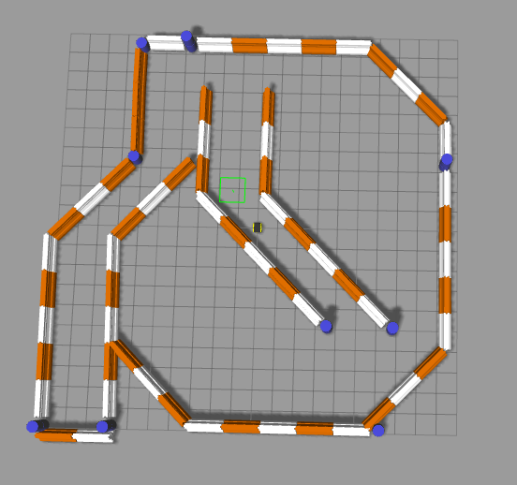
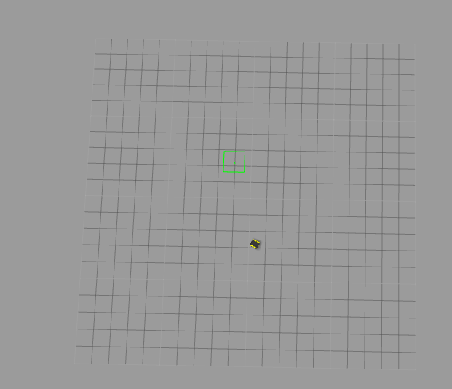
Creating an empty world
Environment with obstacles
Empty.world made by removing obstacles from jackal_race.world
Empty environment

Slide 4
Random Walk & Teleop
Random walk:
Arbitrary linear distance
Arbitrary rotation
5 Hz
Switching - publishing rate
> 10 Hz
“teleop_twist_keyboard” package

Slide 5
Problems Overcome
Continue to overcome ROS learning curve.
Differentiating between teleop and automated control.
Writing a node that publishes and subscribes

Slide 6
Work Partition
James Radwill:
Creating the empty world.
Random walk and
Switching scheme.
Deep Doshi:
Helped integrating the teleop.
Launch file.
Sabari Manohar:
Team Leader
Documentation and Wiki Tutorial.

Slide 7
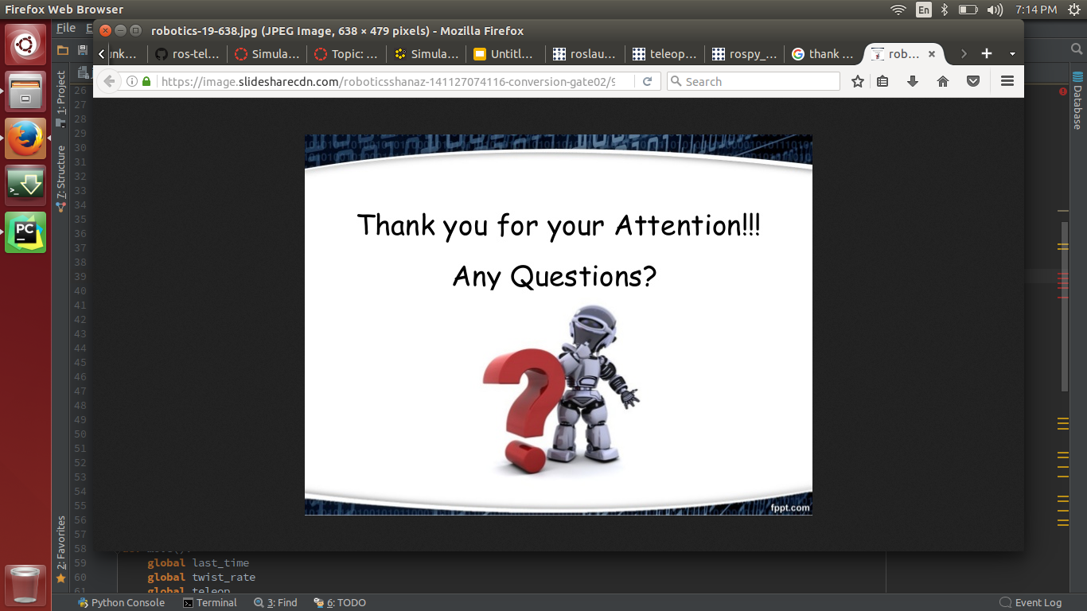
Thank you!

